Slide 1


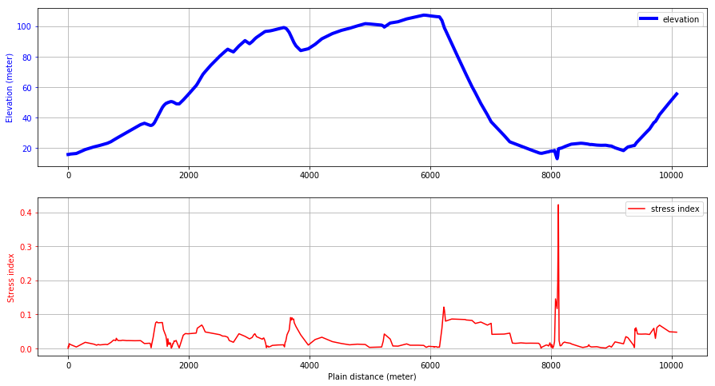
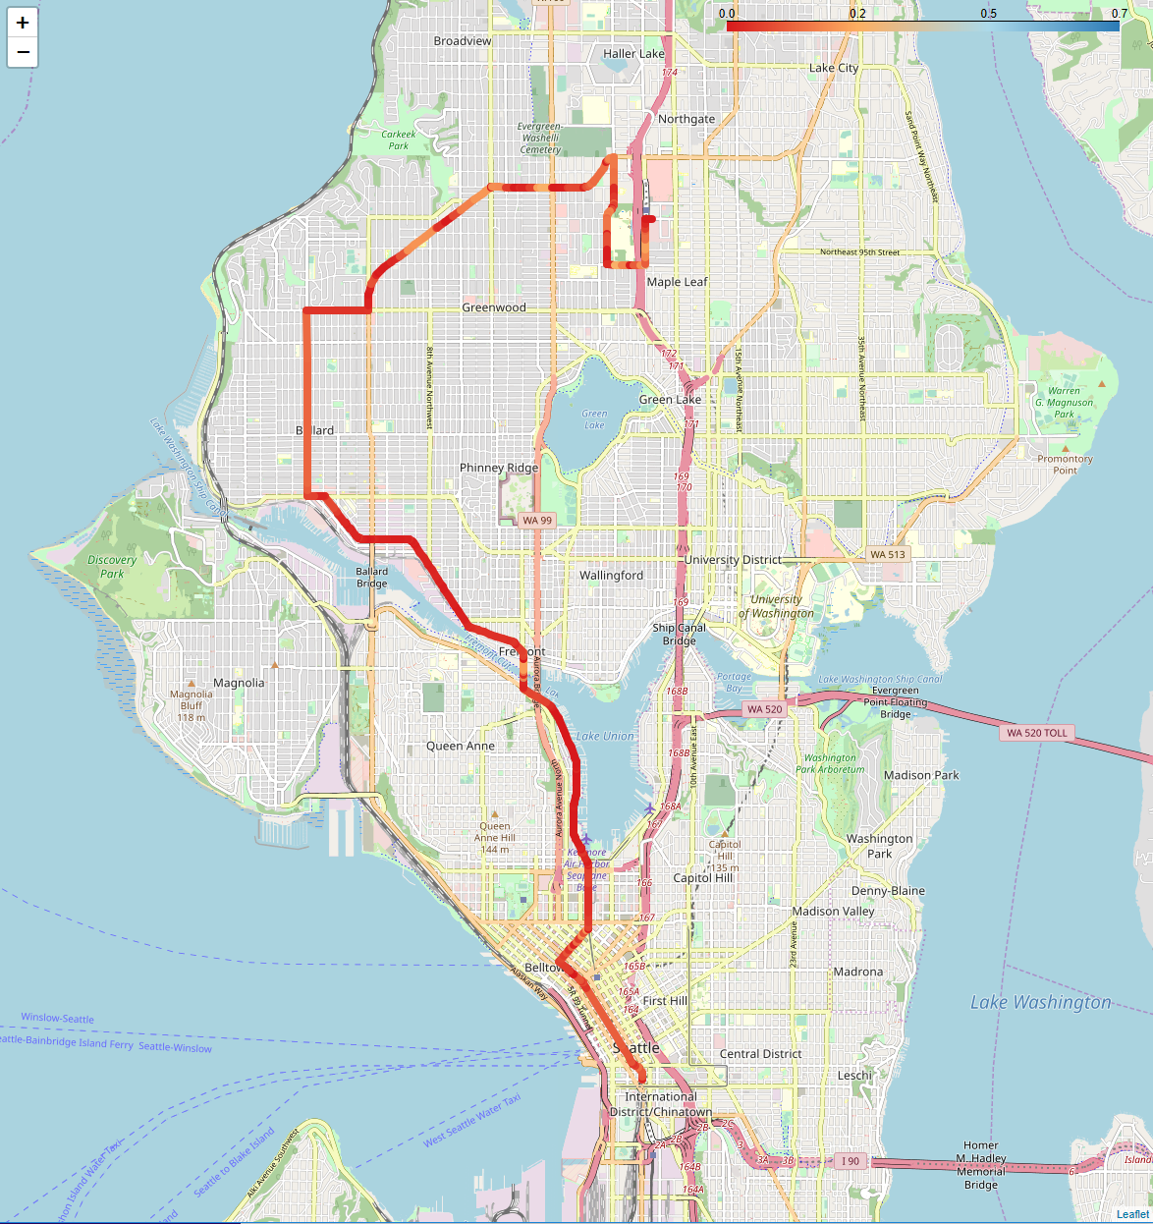
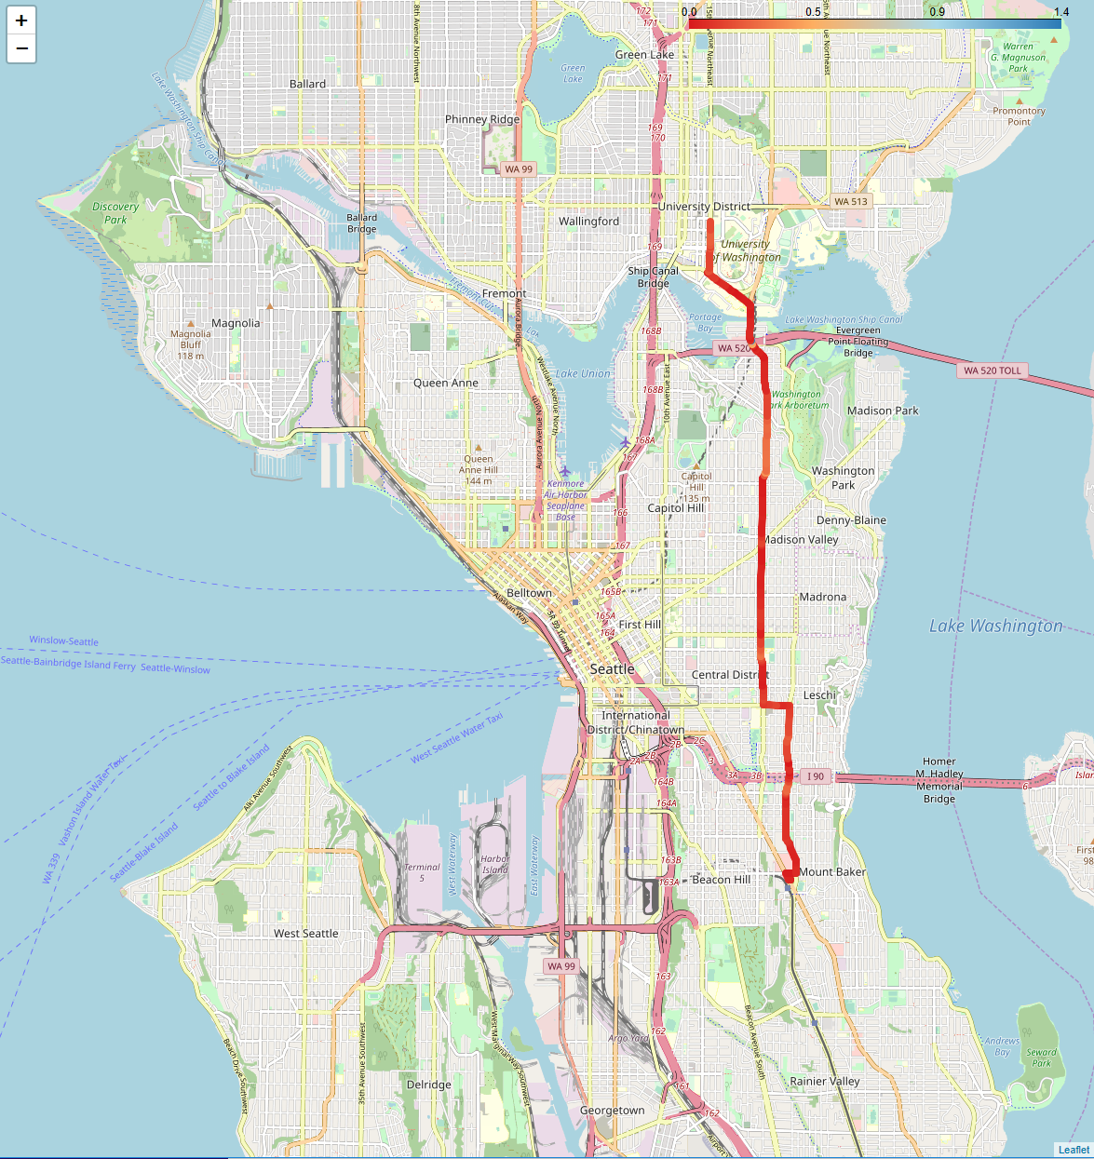
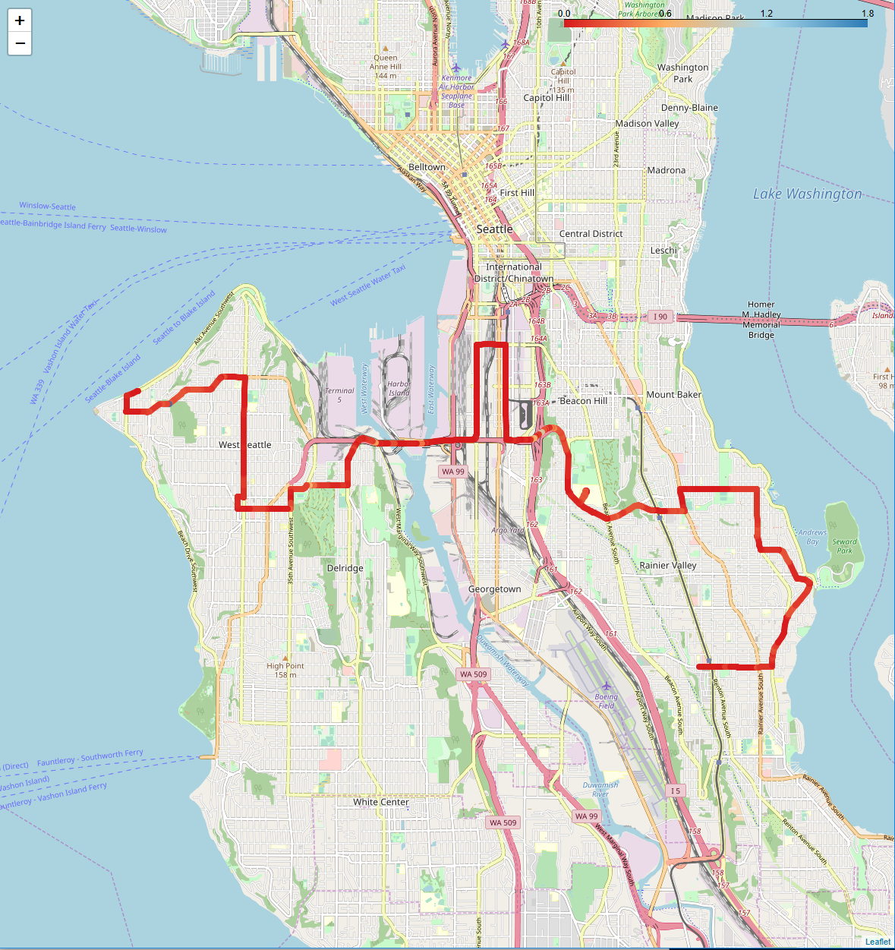
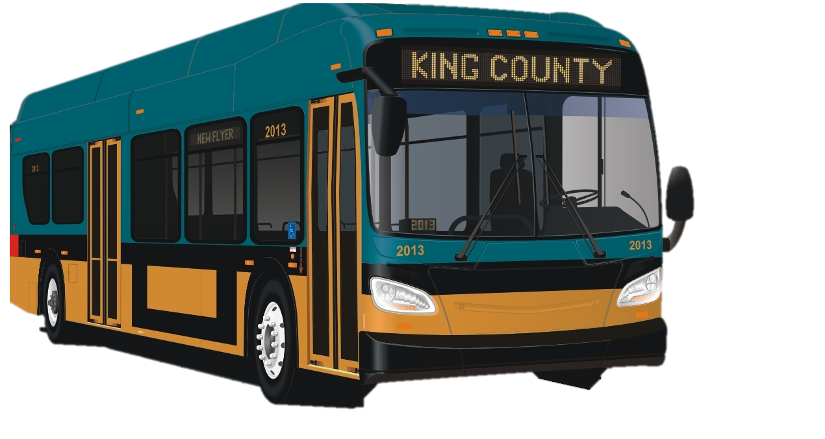
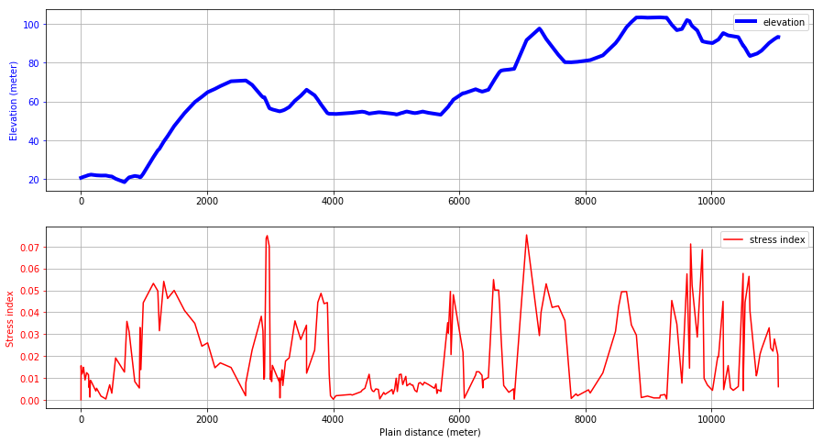
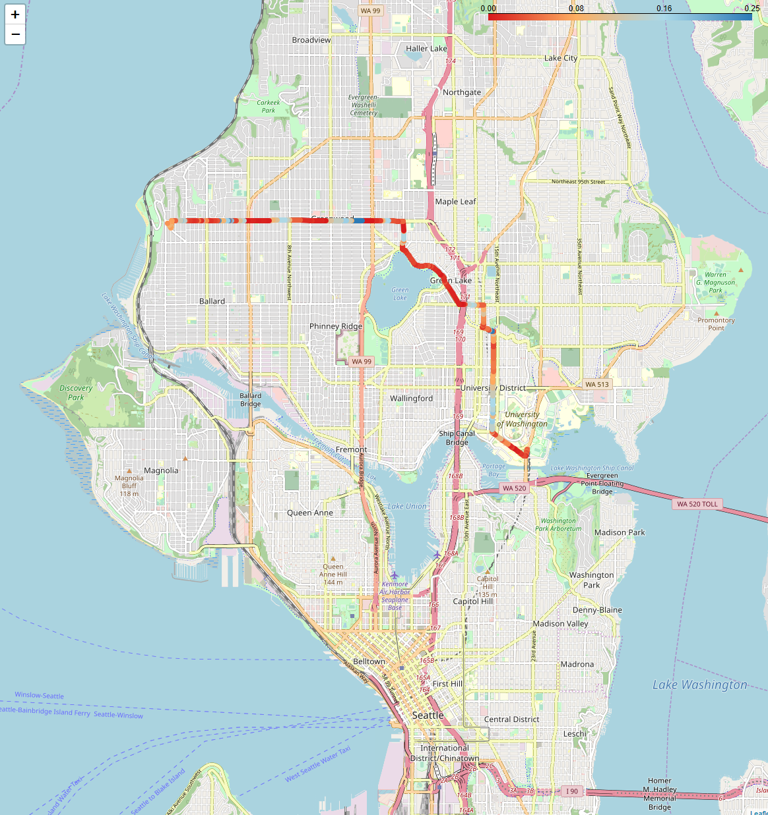
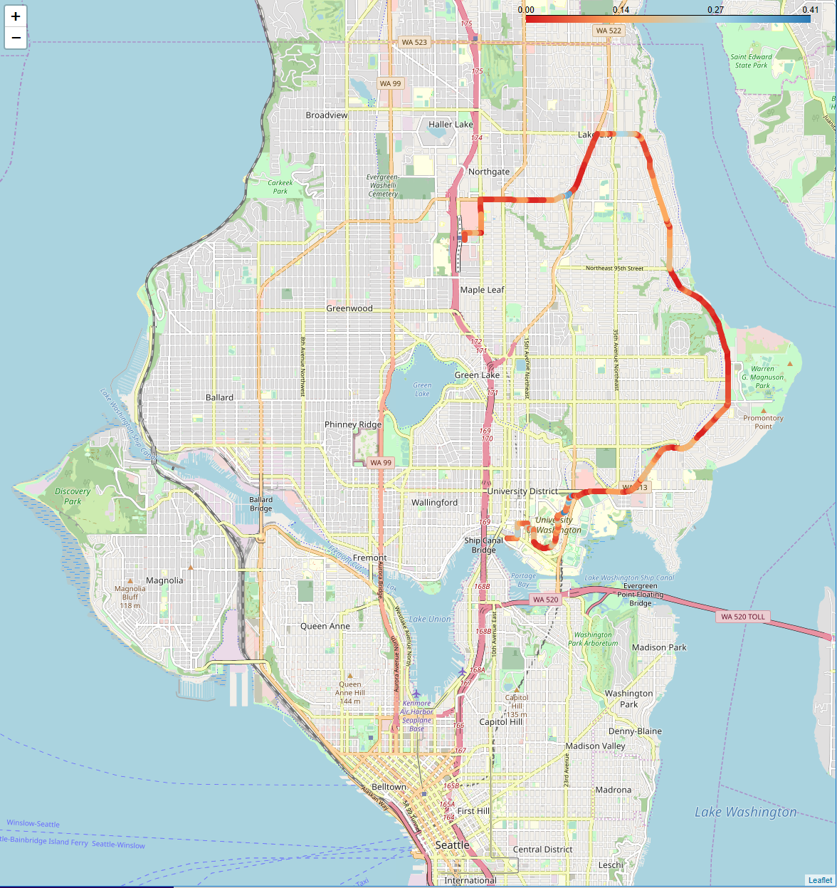
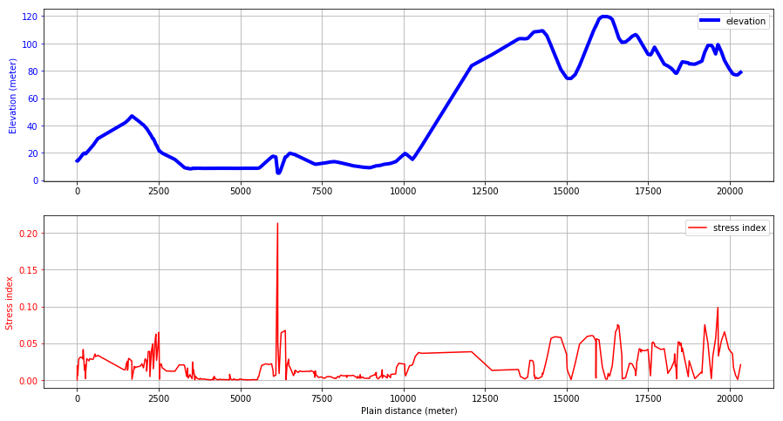
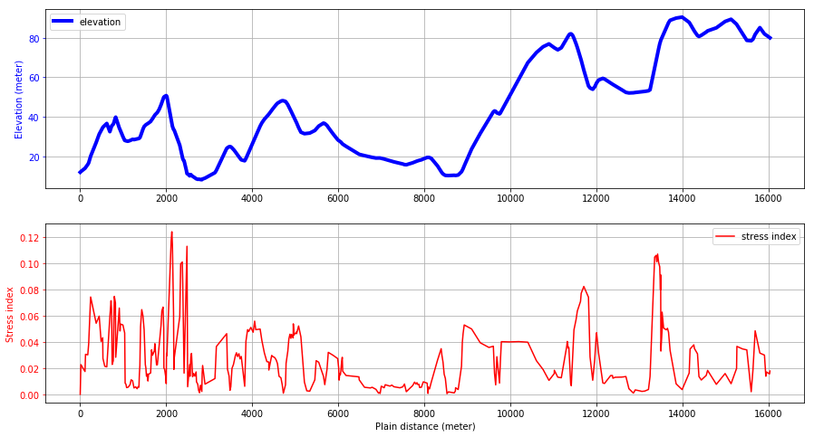
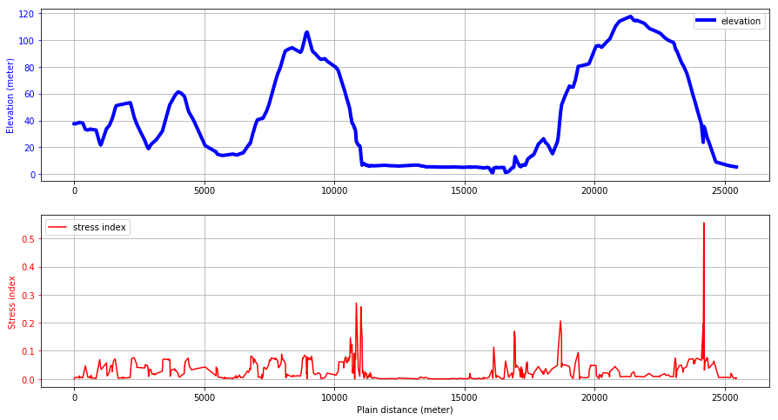
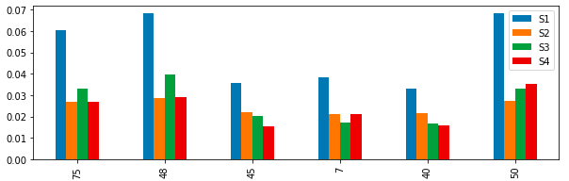
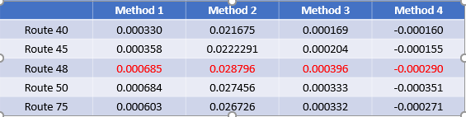


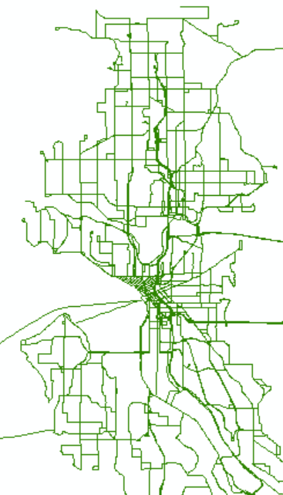
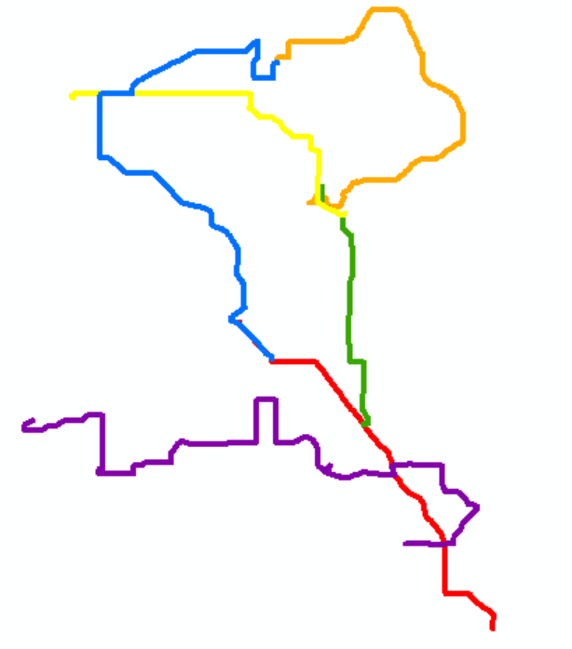
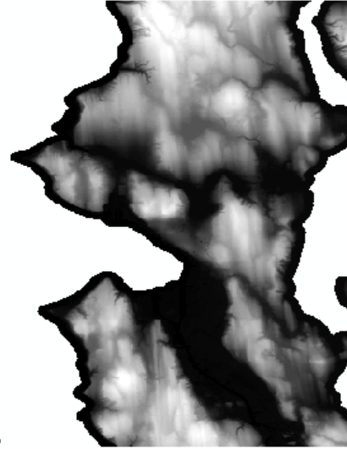
Route_Dynamics: An open-source package for visualizing and ranking transit routes
Atinuke Ademola-Idowu, Erica E. Eggleton, Yohan Min, KM
Objective
Results
Driving up and down hills is a source of stress for batteries in electrified vehicles. This software uses geographic information systems (GIS) data to determine the elevation profiles for King County Metro bus routes and rank the difficulty based on road grade.
Work Flow / Packages
Read Data
Process Data
Analyze Data
Visualize Data
Bus route coordinates from King County Metro
Re-trace routes to extract only one-way bus routes
Extract elevation data for each bus route and merge with route coordinates into a GeoJson format
Display selected bus routes on map using colors to represent elevation gradient
Elevation data for the King County area from Washington Department of Natural Resources
Convert elevation data to coordinate system used by bus routes.
Display plots of selected bus routes’ actual elevation and absolute road grade
Calculate route elevation gradient and compute different stress metrics
Current ranking metrics included in software:
1) Metric = sum(grade) / total route distance
2) Metric = sum(|Elevation distance between points|)/ total route distance
3) Metric = sum(up or down hill grade)/ total route distance
4) Metric = sum(down or up hill grade)/ total route distance
Packages
Geopandas
Shapefile
Rasterstats
Pandas
ArcGIS/ArcMap
Geopandas
Rasterio
Geopandas
Shapely
Geopy
Pandas
Numpy
Folium
Matplotlib
Branca
Json
Input Data Types and Cleaning
Future Work
Add more points (e.g. interpolation) for higher resolution along the route for a smoother elevation profile
Combine elevation surface and terrain models to account for bridges and overpasses
Create Python package for data cleaning
Add stress parameters to get a better estimate of battery fatigue
Bus routes: Shapefile (.shp)
Clean routes
Elevation: Raster file (.tif)
References:

